Slide 1
IPv4 Address and Subnetting
Dr. Sk. Md. Masudul ahsan

Slide 2
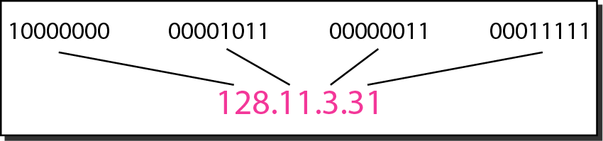
IPv4 address
An IPv4 address is 32 bits long number
Binary notation
Dotted-decimal notation
The IPv4 addresses are unique and universal.
The address space of IPv4 is 2³² or 4,294,967,296.
‹#›
Notes:
‹#›

Slide 3
Network and Host Portions
some portion of the high-order bits represents the network address.
group of hosts that have identical bit patterns in the network address portion of their addresses.
Number of bits used in host portion determines the number of hosts that we can have within the network.
Network
Host
‹#›

Slide 4
Types
Network address - The address by which we refer to the network
All the host bits are set to zero
Cannot be assigned to host devices
Broadcast address - A special address used to send data to all hosts in the network
All the host bits are set to one
Cannot be assigned to host devices
Host addresses - The addresses assigned to the end devices in the network
Any combination of 0/1s except all 0 or all 1s
‹#›

Slide 5
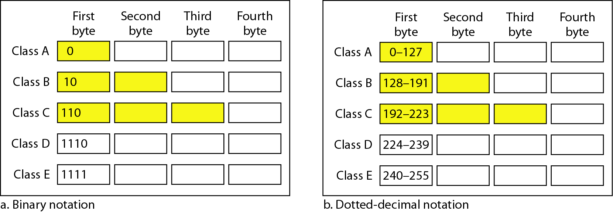
Classful Addressing
the address space is divided into five classes:
A, B, C, D, and E.
Yellow color -> network bits
‹#›
Notes:
‹#›

Slide 6
Classful Addressing
Number of networks and host addresses
Why –2?
Class | # Networks | # host | Application
A | 128 | 16,777,216 – 2 | Unicast
B | 16384 | 65,536 – 2 | Unicast
C | 2,097,152 | 256 – 2 | Unicast
D | 1 | 268,435,456 | Multicast
E | 1 | 268,435,456 | Reserved
‹#›
Notes:
‹#›

Slide 7
Example
Find the class of each address.
a. 00000001 00001011 00001011 11101111
b. 11000001 10000011 00011011 11111111
c. 14.23.120.8
d. 252.5.15.111
Solution
a. The first bit is 0. This is a class A address.
b. The first 2 bits are 1; the third bit is 0. This is a class C address.
c. The first byte is 14; the class is A.
d. The first byte is 252; the class is E.
‹#›
Notes:
‹#›

Slide 8
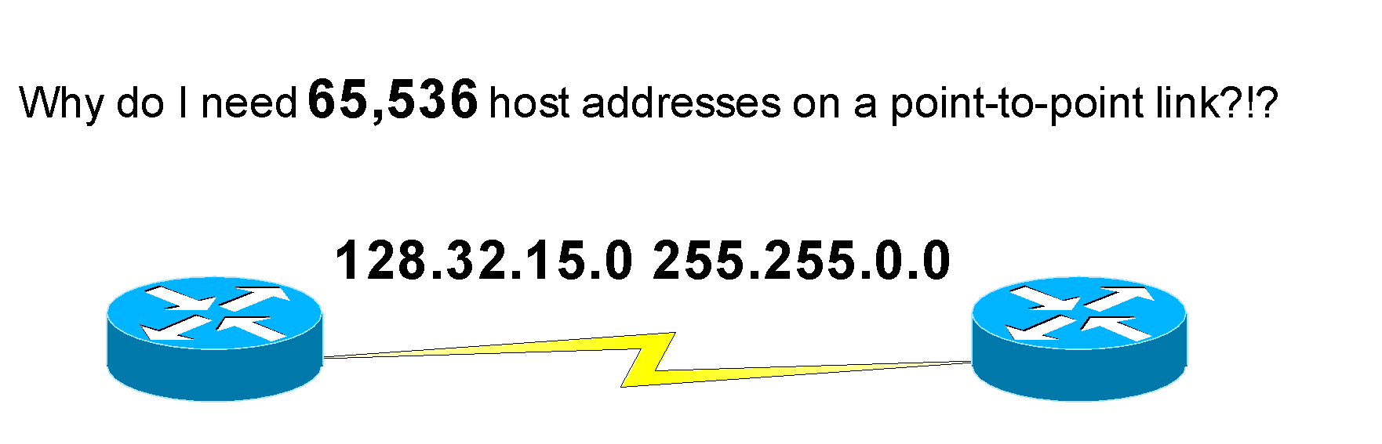
Classless Addressing
In classful addressing, a large part of the available addresses were wasted.
Classful addressing, which is almost obsolete, is replaced with classless addressing.
‹#›
Notes:
‹#›

Slide 9
Classless Addressing – Subnet Mask
With the rapid growth of the internet & the ever-increasing demand for new addresses, the standard address class structure has been expanded by borrowing bits from the Host portion to allow for more Networks.
Problem
How do we know how many bits represent the network portion and how many bits represent the host portion?
Under this addressing scheme, called Subnetting, separating the Network & Host requires a special process called Subnet Masking.
‹#›

Slide 10
Classless Addressing – Subnet Mask
The subnet mask consists of
32 bits, just as the address does,
Uses consecutives 1s and followed by consecutives 0s to indicate network bits and host bits respectively.
Another entity that is used to specify the network portion in an address is called prefix length .
For example, in 172.16.4.0 /24, the /24 is the prefix length - it tells us that the first 24 bits (left most or most significant 24 bits) are the network address.
‹#›

Slide 11
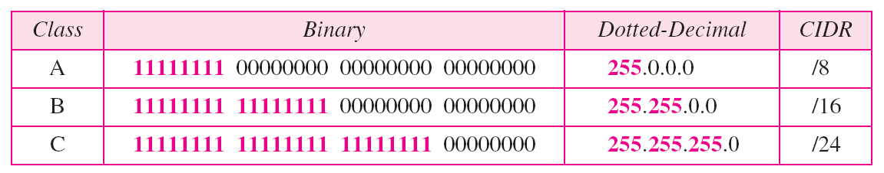
Classless Addressing – Subnet Mask
Default masks for classful addressing
In IPv4 classless addressing, an address can be defined as
x.y.z.t /n
in which x.y.z.t defines one of the addresses and the /n defines the mask.
n can be any number b/w 0 and 32.
‹#›

Slide 12
Subnetting
Concept evolved for classless addressing to overcome the depletion of address space.
Divide a large address block into smaller sub-groups.
Use of flexible net mask.
Restriction
The addresses in a block must be contiguous.
The number of addresses in a block must be a power of 2.
‹#›

Slide 13
Subnetting - Tips:
In IPv4 addressing, a block of addresses can be defined as x.y.z.t /n, in which x.y.z.t defines one of the addresses and the /n defines the mask.
The first address in the block can be found by setting the rightmost 32 − n bits to 0s.
The last address in the block can be found by setting the rightmost 32 − n bits to 1s.
The number of addresses in the block can be found by using the formula 2^{32−n}.
‹#›

Slide 14
Subnetting to Meet Requirements
Subnetting Based on Host Requirements
The number of host addresses required for each network.
Subnetting Based on Network Requirements
The number of individual subnets needed.
Administrators may be asked to subnet an IP range to accommodate a specific number of networks.
Think of a company with 7 departments where each department must have its own subnetwork.
The number of hosts per subnet, while secondary, is also important.
Network Requirement Example
Assume the range 200.42.98.0/24 was given to the administrator.
7 subnets must be created.
Each department will have no more than 29 hosts.
A subnet mask of /27 applied to 200.42.98.0/24, creates 8 networks with 30 hosts in each network.
Notes:
‹#›
8.1 – Subnetting an IPv4 Network
8.1.4 – Subnetting to Meet Requirements

Slide 15
The Problem - 01
Let you are assigned an address block, with network address: 140.269.8.0 /22
But you need 5 subnetworks, subnet the network to meet your demand with - Host IP loss should be as minimum as possible
How many subnets created?
How many host addresses/subnet?
Consider subnet # 5, and Find
Network Address of the subnet
First, Last host address
Broadcast address
How many Host IP address losses due to subnetting?

Slide 16
The Problem - 02
Let an ISP is assigned an address block, and consider one of the address from that block is 20.69.11.0 /22
You need some subnets (no. doesn’t matter) – but each subnet should have at least 15 hosts support
Subnet the network to meet your goal ( Host IP loss should be as minimum as possible)
How many subnets?
Consider subnet # 12, and Find
Network Address of the subnet
First, Last host address
Broadcast address
Unnecessary Host address in the subnet
How many Host address losses for subnetting?

Slide 17
Solution
Given Address: 20.69.11.0 = 20.69.00001011.0
Given Mask : 255.255.252.0 = 255.255.11111100.0
Given Network : 20.69.8.0 = 20.69.00001000.0
Net Bits in given Address = 12
Required 15 Hosts / subnet
Required Host Bits = 5 ( why? 2⁴ = 16, 2⁵ = 32 )
Bits remain for subnetting = 32 – 22 – 5 = 5
ANS
1. Total subnets = 2^{Subnet Bits} = 2⁵ = 32

Slide 18
Solution
20.69.00001000.00000000 (20.69.8.0)
Binary for 12
8 4 2 1
1 0 1 0 ( 4 bits only)
Host Bits
Given Net Bits. It will be fixed
Bits for Subnetting

Slide 19
Solution
Now consider Subnet Bits, and Host Bits just as place holder
20 .69. 000010 _ _ . _ _ _ _ _ _ _
5 places for subnet bits
But the binary of 12 has only 4 bits
Put One additional 0 before the binary number
And place it in the place holder of Subnet bits
20.69. 00001 0 1 . 0 1 0 _ _ _ _ _
New Network Bits ( Total 27 bits)
20.69. 00001 0 1. 0 1 0 _ _ _ _ _

Slide 20
Solution
Now for Subnet address place 0 on host bits
20.69. 00001 0 1. 0 1 0 0 0 0 0 0
20 . 69 . 9 . 64 / 27 is the Subnet Address
For Broadcast address place 1 on host bits
20.69. 00001 0 1. 0 1 0 1 1 1 1 1
20 . 69 . 9 . 95 is the Broadcast Address

Slide 21
Solution
For First Address just add 1 with Net address
20 . 69 . 9 . 0
+ 1
20 . 69 . 9 . 1
For Last Address just subtract 1 from broadcast address
20 . 69 . 9 . 95
- 1
20 . 69 . 9 . 94

Slide 22
Solution
2.d) Host IP in each subnet = (2⁵ – 2) = 30
Unnecessary Host IPs = 30 – 15 = 15
3. Host IP losses for subnetting
Total Host IPs in Original Net = 2^{Host Bits} = 2¹⁰ – 2 = A
Host IPs in subnets = Total subnet X Host IP in each subnet
= 2⁵ x (2⁵ – 2) = B
Losses = A – B = (2¹⁰ – 2) – 2⁵ x (2⁵ – 2)
= 2¹⁰ – 2¹⁰ + 2 x 2⁵ – 2
= 62

Slide 23
The Problem – 03 (DIY at lab)
Let an ISP is assigned an address block, and consider one of the address from that block is 20.69.0.0 /10
You need some subnets (no. doesn’t matter) – but each subnet should have at least 3600 hosts support
Subnet the network to meet your goal ( Host IP loss should be as minimum as possible)
How many subnets?
Consider subnet # 373, and Find
Network Address of the subnet
First, Last host address
Broadcast address
Unnecessary Host address in the subnet
How many Host address losses for subnetting?

Slide 24
Solution
Given Address: 20.69.0.0 = 20.01000101.0.0
Given Mask : 255.192.0.0 = 255.11000000.0.0
Given Network : 20.64.0.0 = 20.01000000.0.0
Net Bits in given Address = 10
Required 3600 Hosts / subnet
Required Host Bits = 12 ( why? 2¹¹ = 2048, 2¹² = 4096 )
Bits remain for subnetting = 32 – 10 – 12 = 10
ANS
1. Total subnets = 2^{Subnet Bits} = 2¹⁰ = 1024

Slide 25
Solution
20.01000000.00000000.00000000 (20.64.0.0)
Binary for 373
256 128 64 32 16 8 4 2 1
1 0 1 1 1 0 1 0 1 ( 9 bits only)
Host Bits
Given Net Bits. It will be fixed
Bits for Subnetting

Slide 26
Solution
Now consider Subnet Bits, and Host Bits just as place holder
20 . 01_ _ _ _ _ _ . _ _ _ _ _ _ _ _ . _ _ _ _ _ _ _ _
10 places for subnet bits
But the binary of 373 has only 9 bits
Put One additional 0 before the binary number
And place it in the place holder of Subnet bits
20. 01 0 1 0 1 1 1 . 0 1 0 1 _ _ _ _ . _ _ _ _ _ _ _ _
New Network Bits ( Total 20 bits)
20. 01 0 1 0 1 1 1 . 0 1 0 1 _ _ _ _ . _ _ _ _ _ _ _ _

Slide 27
Solution
Now for Subnet address place 0 on host bits
20. 01 0 1 0 1 1 1 . 0 1 0 1 0 0 0 0 . 0 0 0 0 0 0 0 0
20 . 87 . 80 . 0 / 20 is the Subnet Address
For Broadcast address place 1 on host bits
20. 01 0 1 0 1 1 1 . 0 1 0 1 1 1 1 1 . 1 1 1 1 1 1 1 1
20 . 87 . 95 . 255 is the Subnet Address

Slide 28
Solution
For First Address just add 1 with Net address
20 . 87 . 80 . 0
+ 1
20 . 87 . 80 . 1
For Last Address just subtract 1 from broadcast address
20 . 87 . 95 . 255
- 1
20 . 87 . 95 . 254

Slide 29
Solution
2.d) Host IP in each subnet = (2¹² – 2) = 4094
Unnecessary Host IPs = 4094 – 3600 = 494
3. Host IP losses for subnetting
Total Host IPs in Original Net = 2^{Host Bits} = 2²² – 2 = A
Host IPs in subnets = Total subnet X Host IP in each subnet
= 2¹⁰ x (2¹² – 2) = B
Losses = A – B = (2²² – 2) – 2¹⁰ x (2¹² – 2)
= 2²² – 2²² + 2¹¹ – 2 = 2046

Slide 30
The Problem – 03 (DIY at lab)
Let an ISP is assigned an address block, and consider one of the address from that block is 20.69.0.0 /10
You need 1023 subnets
Subnet the network to meet your goal ( Host IP loss should be as minimum as possible)
How many subnets created?
How many host addresses/subnet?
Consider subnet # (reverse_of(first digit+roll_no) )5, and Find
Network Address of the subnet
First, Last host address
Broadcast address
How many Host IP address losses due to subnetting?

